Slide 1
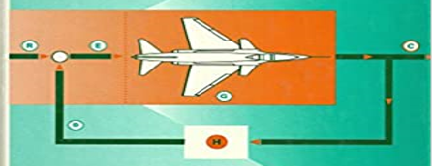
SECOND-WEEK
Dr. Wazir Muhammad
Electrical Engineering Department
BUET, Khuzdar

Slide 2
Centroid

Slide 3
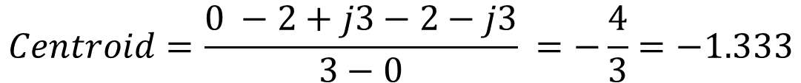
$$Centroid=\frac{\sum{poles − \sum{zeros}}}{n−m}=\frac{{{{(P}_{1}+P}_{2}+P}_{3}) −(0)}{P−Z}=\frac{0 −2+j3−2−j3}{3−0}$$
$$Centroid=\frac{0 −2+j3−2−j3}{3−0} =−\frac{4}{3}=−1.333$$

Slide 4
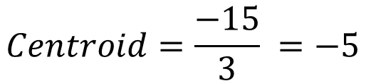
EXAMPLE: Suppose poles of control system P = 0, -5, and -10 having no zeros. Calculate the Centroid and Angle of Asymptotes
$$Centroid=\frac{\sum{poles − \sum{zeros}}}{Number of Poles−Number of Zeros}=\frac{{{{(P}_{1}+P}_{2}+P}_{3}) −(0)}{P−Z}=\frac{0 −5 −10}{3−0}$$
$$Centroid=\frac{−15}{3} =−5$$

Slide 5
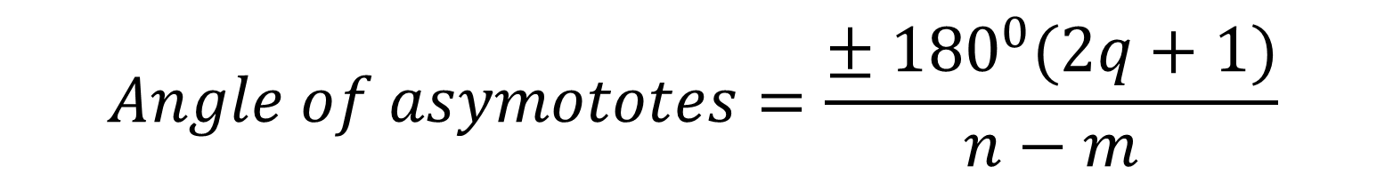
$$Angle of asymototes=\frac{± {180}^{0}(2q+1)}{n−m}$$
$$n −No. of poles;m=No. of zeros, q=0, 1, 2, …n−m$$
$$if q=0 ↔AoA=\frac{± {180}^{0}(2q+1)}{n−m}=\frac{± {180}^{0}(2∗0+1)}{3−0}=± {60}^{0}$$
$$if q=1 ↔AoA=\frac{± {180}^{0}(2q+1)}{n−m}=\frac{± {180}^{0}(2∗1+1)}{3−0}=±180^{0}$$
$$if q=2↔AoA=\frac{± {180}^{0}(2q+1)}{n−m}=\frac{± {180}^{0}(2∗2+1)}{3−0}=±300^{0}$$

Slide 6
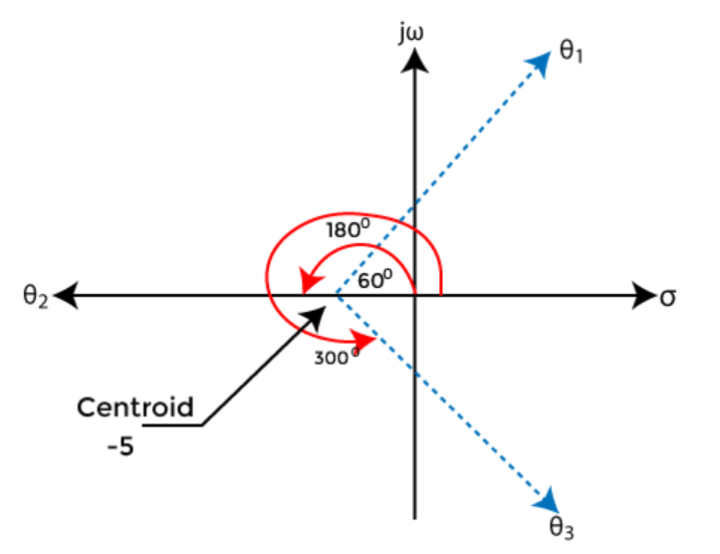

Slide 7
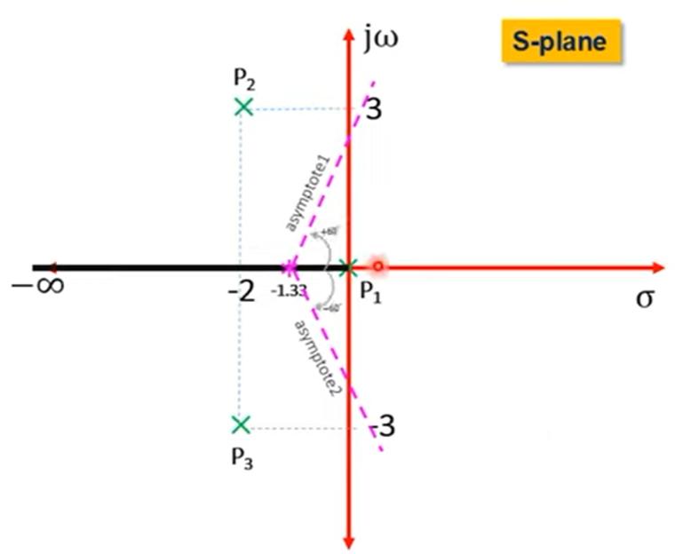

Slide 8
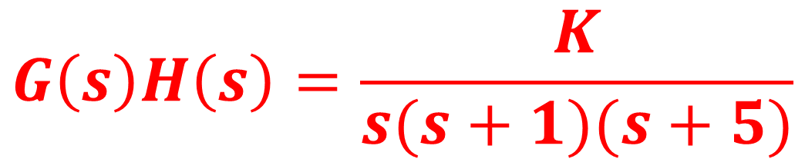
Example: Draw the root locus of the control system having open loop transfer function
$$G\left(s\right)H\left(s\right)=\frac{K}{s(s+1)(s+5)}$$

Slide 9
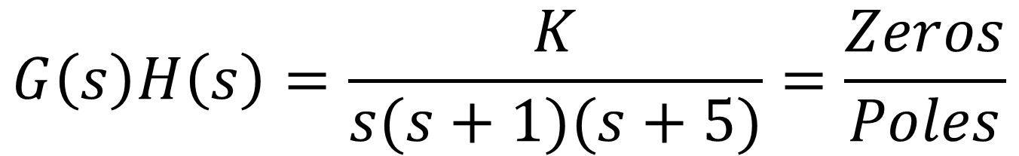
STEP-1: Calculate No of Poles and Zeros
$$G\left(s\right)H\left(s\right)=\frac{K}{s(s+1)(s+5)}=\frac{Zeros}{Poles}$$
$$Poles →P_{1}=0;P_{2}=−1;P_{3}=−5;$$
$$Zeros →Z=0, because no s term in Numerator$$

Slide 10
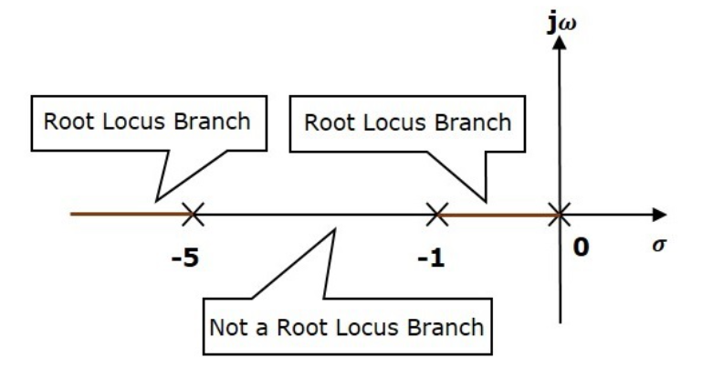
Step-2: Find the Root Locus Branch
Take one test point on inspecting region, if the point is having odd number of right side poles and /or zeros, the region is root locus or else it is not root locus.
$$Poles →P_{1}=0;P_{2}=−1;P_{3}=−5;$$
$$No: of Root Locus Branches=No: of Poles=N=P=3$$

Slide 11
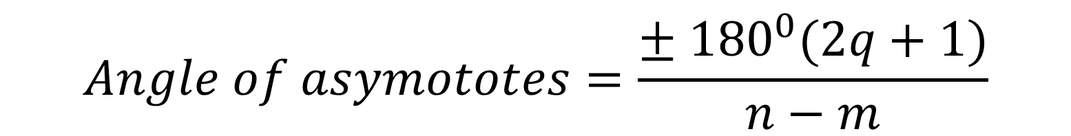
Step-3: Angle of Asymptotes
$$Angle of asymototes=\frac{± {180}^{0}(2q+1)}{n−m}$$
$$n −No. of poles;m=No. of zeros, q=0, 1, 2, …n−m$$
$$if q=0 ↔AoA=\frac{± {180}^{0}(2q+1)}{n−m}=\frac{± {180}^{0}(2∗0+1)}{3−0}=± {60}^{0}$$
$$if q=1 ↔AoA=\frac{± {180}^{0}(2q+1)}{n−m}=\frac{± {180}^{0}(2∗1+1)}{3−0}=±180^{0}$$
$$if q=2↔AoA=\frac{± {180}^{0}(2q+1)}{n−m}=\frac{± {180}^{0}(2∗2+1)}{3−0}=±300^{0}$$

Slide 12
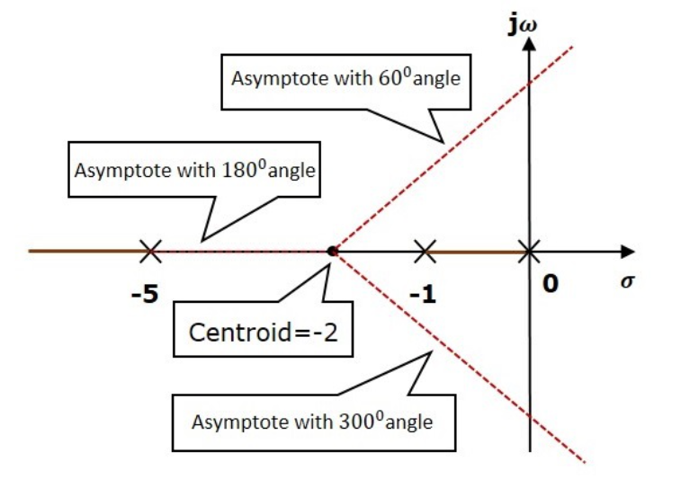
Step-4: Centroid
$$Poles →P_{1}=0;P_{2}=−1;P_{3}=−5;$$
$$Centroid=\frac{\sum{poles − \sum{zeros}}}{Number of Poles−Number of Zeros}=\frac{{{{(P}_{1}+P}_{2}+P}_{3}) −(0)}{P−Z}=\frac{0 −1 −5}{3−0}$$
$$Centroid=\frac{\sum{poles − \sum{zeros}}}{Number of Poles−Number of Zeros}=\frac{−6}{3}=−2$$

Slide 13
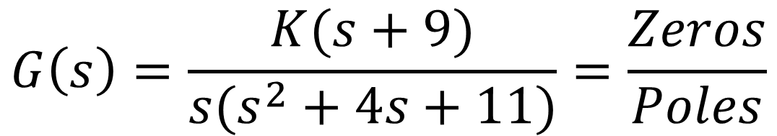
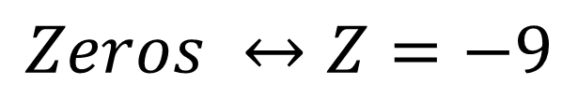
Angle of Departure
If we have a complex poles, than we used Angle of Departure.
$$G\left(s\right)=\frac{K(s+9)}{s(s^{2}+4s+11)}=\frac{Zeros}{Poles}$$
$$Poles ↔P=0, −2+j2.64, −2−j2.64$$
$$Zeros ↔Z=−9$$
In this case Complex poles are available, so calculate the Angle of Departure

Slide 14
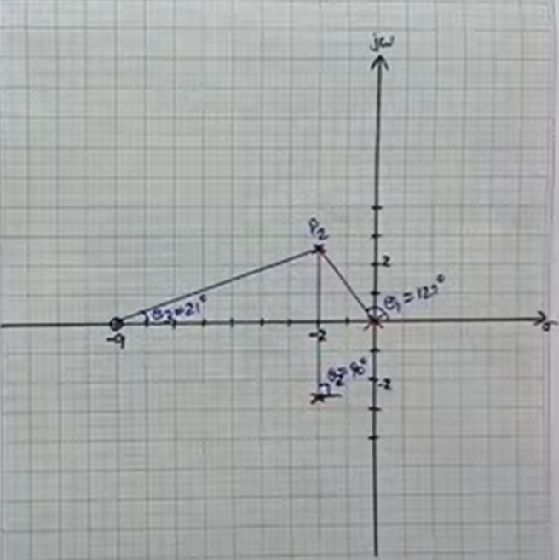
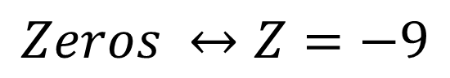
Calculate The Angle of Departure
$$Poles ↔P=0, −2+j2.64, −2−j2.64$$
$$Zeros ↔Z=−9$$
Choose any pole and connect all other poles with selected pole, in this case we select +j2.64 as a reference pole
$$Angle of Deaprture=180 −(sum of remaining poles except refrence pole\left(P_{2} \right)+(sum of remaining zeros)$$
$$Angle of Deaprture=180 −\left(127+90\right)+\left(21\right)=−{17}^{0}$$

Slide 15
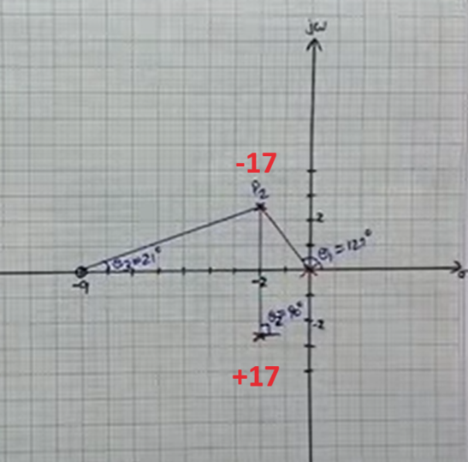
Calculate The Angle of Departure

Slide 16
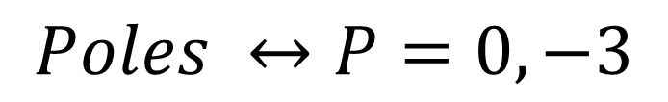
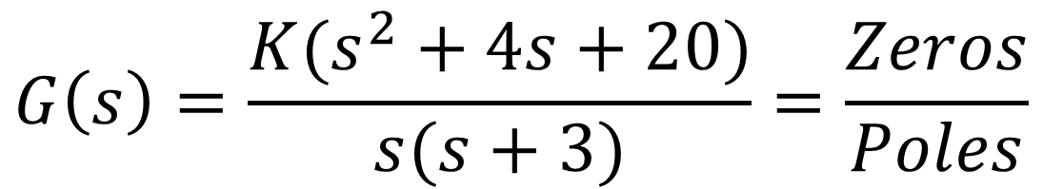
Angle of Arrival
If we have a complex zeros, than we used Angle of Arrival
$$G\left(s\right)=\frac{K(s^{2}+4s+20)}{s(s+3)}=\frac{Zeros}{Poles}$$
$$Poles ↔P=0, −3$$
$$Zeros ↔Z=−2+j4; −2 −j4$$
In this case Complex Zeros are available, so calculate the Angle of Arrival

Slide 17
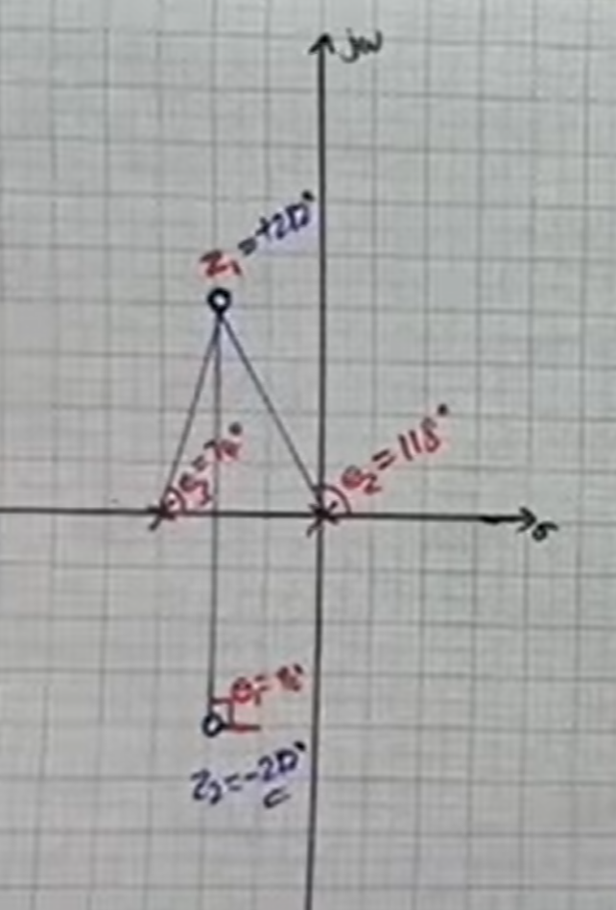
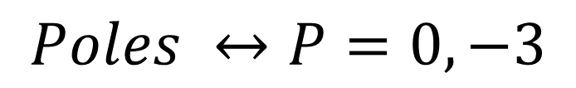
Calculate The Angle of Arrival
$$Poles ↔P=0, −3$$
$$Zeros ↔Z=−2+j4; −2 −j4$$
Choose any zero and connect all other zeros with selected zero, in this case we select +j4 as a reference pole
$$Angle of Arrival=180 −(sum of remaining zeros except refrence zero\left(Z \right)+(sum of remaining Poles)$$
$$Angle of Deaprture=180 −\left(−90\right)+\left(118+74\right)={282}^{0}$$

Slide 18
Calculate The Angle of Arrival
AOA = 282
AOA = -282

Slide 19
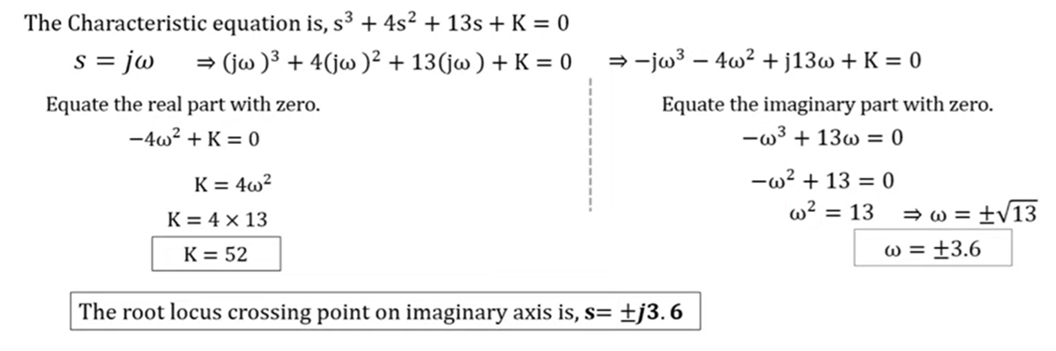
Finding the Crossing Point of Root Locus

Slide 20
Root Locus Method
It is the combination of two words: root-loci
We are interested in the roots of the Denominator of the closed loop transfer function, that is the closed loop poles.
Locus is a path (or route) one might follow. Loci is the plural form.
The root locus is the path of the roots of the characteristic equation traced out in the s-plane as a system parameter varies from zero to infinity.
It is a graphical method for examining the change in the roots of a system when gain of the system varies.
Root-loci are the paths followed by the closed loop poles as K changes, because poles are tell us about stability and behavior.

Slide 21
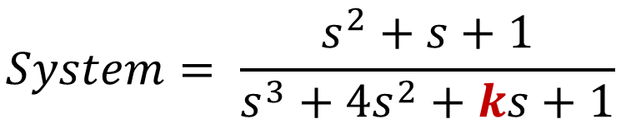
Root Locus Method
System
Parameter K,
Where K is unknown Parameters and what affect on the stability of the system
Input
Output
$$System= \frac{s^{2}+s+1}{s^{3}+{4s}^{2}+ks+1}$$
So here two problems occur due to K
First what value of K we should select to meet my system performance requirements.
Second what is the effect of a variation of K on the system

Slide 22
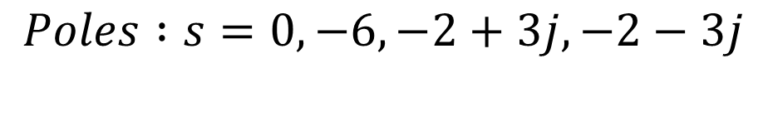
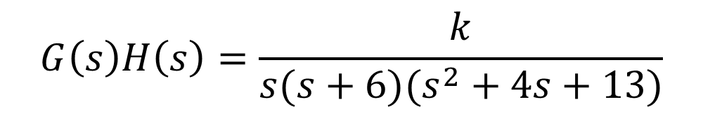
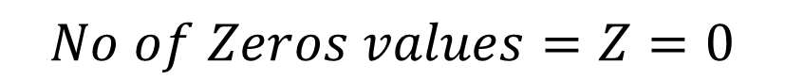
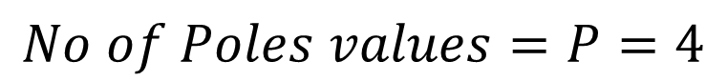
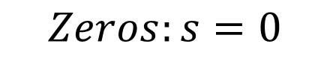
Procedure of Root Locus
$$G\left(s\right)H\left(s\right)=\frac{k}{s(s+6)(s^{2}+4s+13)}$$
Step-1: Calculate the Starting Points (Poles)
$$Poles :s=0, −6, −2+3j, −2−3j$$
$$No of Poles values=P=4$$
Step-2: Calculate the Ending Points (Zeros)
$$Zeros:s=0$$
$$No of Zeros values=Z=0$$
Step-3: Calculate the Numerator of root locus N
P>Z (4>0) than N = P
$N=4$

Slide 23
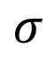
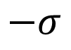
Procedure of Root Locus
$$jσ$$
Step-4: Existence of Root Locus in S-Plane
$$Poles :s=0, −6, −2+3j, −2−3j$$
3j 2j j
$$Zeros:s=None, No:of Zeros=0$$
$$−σ$$
$$σ$$
-6 -5 -4 -3 -2 -1
1 2 3 4 5
-j -2j -3j
Shaded because odd poles on right side
Shaded because 3 poles on right side so
it is odd poles we shaded it
So, root locus exists between 0 to -6.
$$−jσ$$

Slide 24
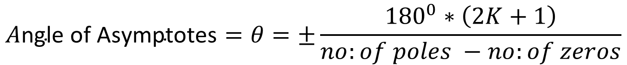
Procedure of Root Locus
Step-5: Angle of Asymptotes
$$A\text{ngle} \text{of} \text{Asymptotes}=θ=±\frac{{180}^{0}∗\left(2K+1\right)}{no:of poles −no:of zeros}$$
$K=p−z−1=4−0−1=3,$ So value of K = 0,1,2,3
$$If K=0 than −→A\text{ngle} \text{of} \text{Asymptotes}=θ_{1}=\frac{{180}^{0}∗\left(2K+1\right)}{no:of poles −no:of zeros}=\frac{{180}^{0}∗\left(2∗0+1\right)∗}{\left(4−0\right)}=\frac{{180}^{0}}{4}={45}^{0}$$
$$If K=1 than −→A\text{ngle} \text{of} \text{Asymptotes}=θ_{2}=\frac{{180}^{0}∗\left(2K+1\right)}{no:of poles −no:of zeros}=\frac{{180}^{0}∗\left(2∗1+1\right)∗}{\left(4−0\right)}=\frac{{180}^{0}∗3}{4}={135}^{0}$$
$$If K=2 than −→A\text{ngle} \text{of} \text{Asymptotes}=θ_{3}=\frac{{180}^{0}∗\left(2K+1\right)}{no:of poles −no:of zeros}=\frac{{180}^{0}∗\left(2∗2+1\right)∗}{\left(4−0\right)}=\frac{{180}^{0}∗5}{4}={225}^{0}$$
$$If K=3 than −→A\text{ngle} \text{of} \text{Asymptotes}=θ_{4}=\frac{{180}^{0}∗\left(2K+1\right)}{no:of poles −no:of zeros}=\frac{{180}^{0}∗\left(2∗3+1\right)∗}{\left(4−0\right)}=\frac{{180}^{0}∗7}{4}={315}^{0}$$

Slide 25
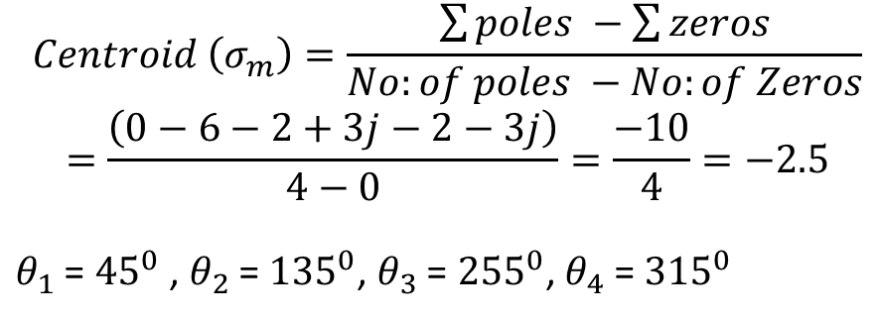
Procedure of Root Locus
$$jσ$$
Step-6: Find the Centroid
$$Centroid \left(σ_{m}\right)=\frac{\sum{poles −\sum{zeros}}}{No:of poles −No:of Zeros}$$
$$=\frac{\left(0−6−2+3j−2−3j\right)}{4−0}=\frac{−10}{4}=−2.5$$
$θ_{1}$ = ${45}^{0}$ , $θ_{2}$ = ${135}^{0}$, $θ_{3}$ = ${255}^{0}$, $θ_{4}$ = ${315}^{0}$
3j 2j j
$$−σ$$
$$σ$$
-6 -5 -4 -3 -2 -1
1 2 3 4 5
-j -2j -3j
$$−jσ$$

Slide 26
Procedure of Root Locus
Step-7: Break Away Point and Break In Point
Break Point
Break Point at which two or more poles are meet (in the real order roort of locus branches) is called Break Point
Homework

Slide 27
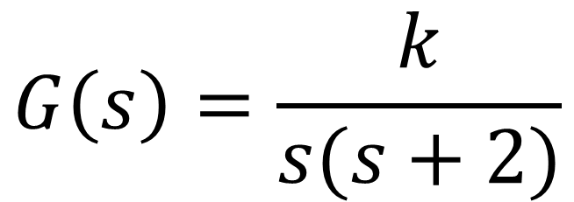
Obtain the root-locus plot for the unity feedback system with transfer function given below is:
$$G\left(s\right)=\frac{k}{s(s+2)}$$

Slide 28
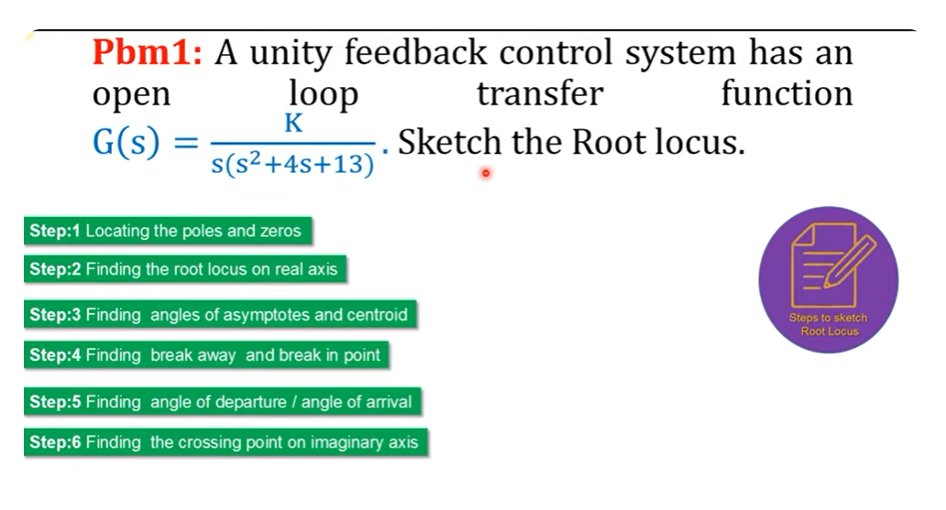
Finding the root locus on real axis

Slide 29
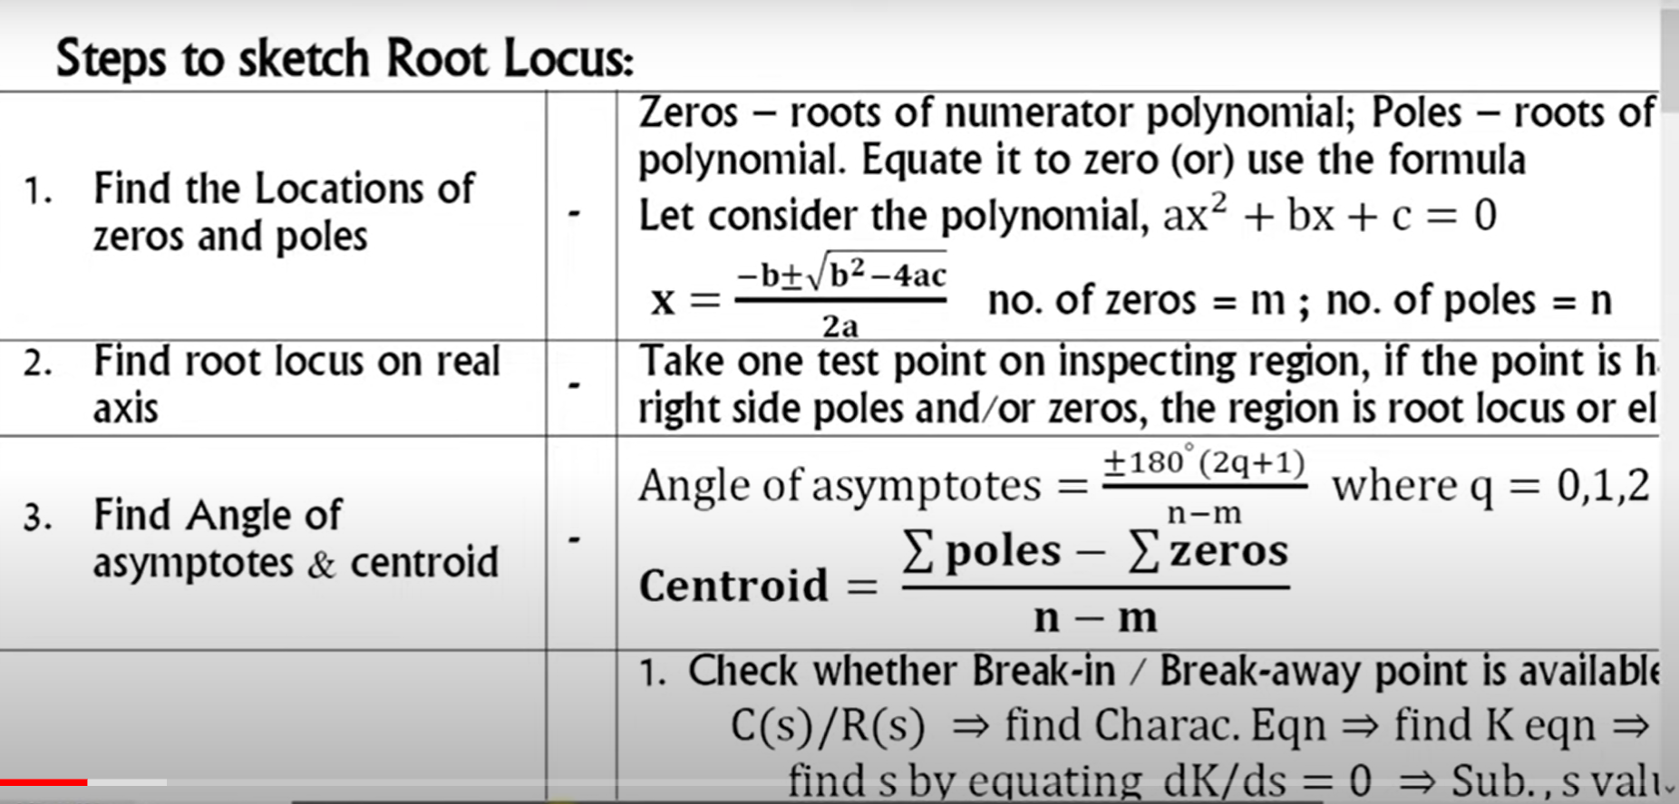
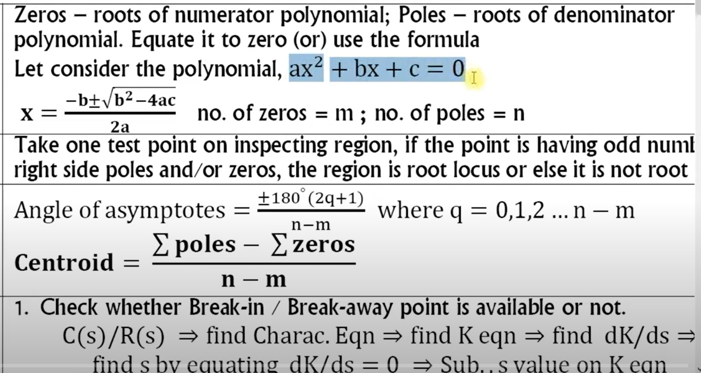
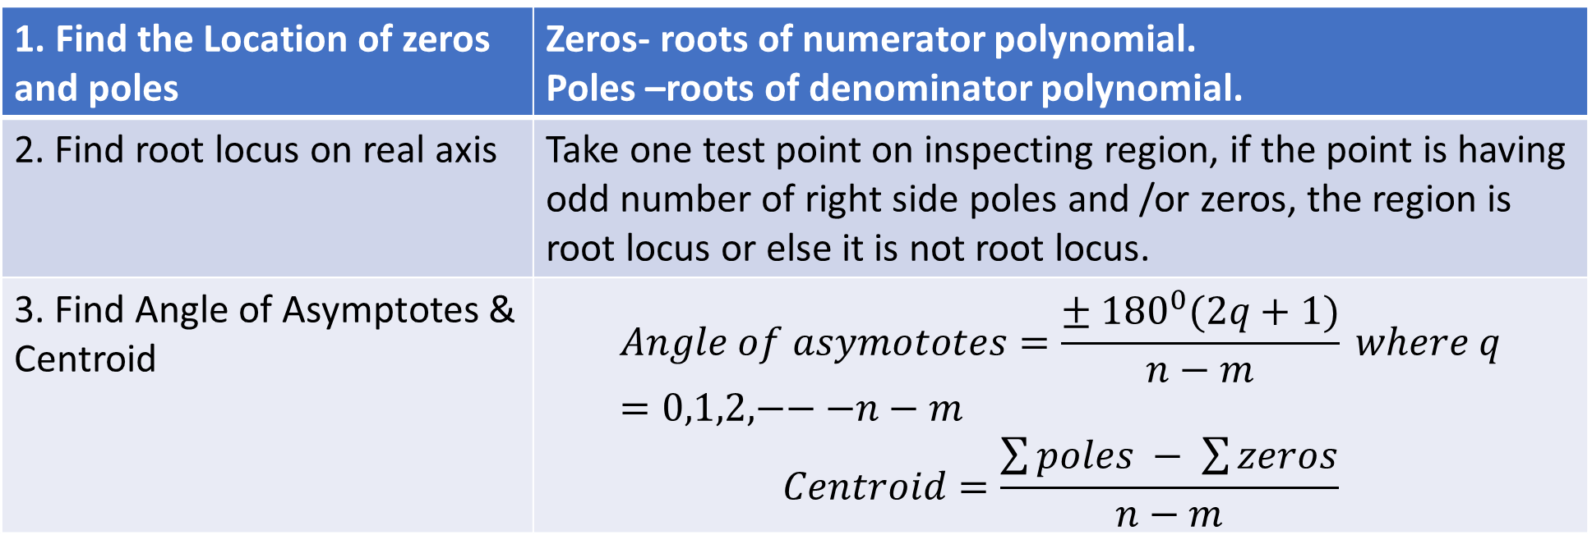
1. Find the Location of zeros and poles | Zeros- roots of numerator polynomial. Poles –roots of denominator polynomial.
2. Find root locus on real axis | Take one test point on inspecting region, if the point is having odd number of right side poles and /or zeros, the region is root locus or else it is not root locus.
3. Find Angle of Asymptotes & Centroid | $$Angle of asymototes=\frac{± {180}^{0}(2q+1)}{n−m} where q=0,1,2,−−−n−m$$ $$Centroid=\frac{\sum{poles − \sum{zeros}}}{n−m}$$

Slide 30
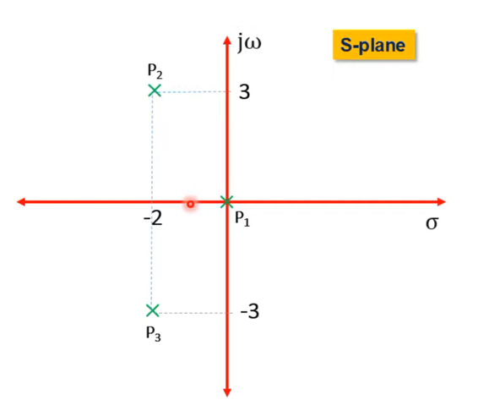
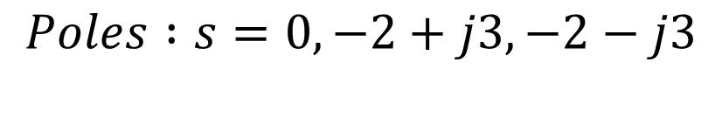
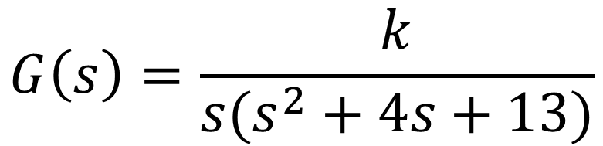
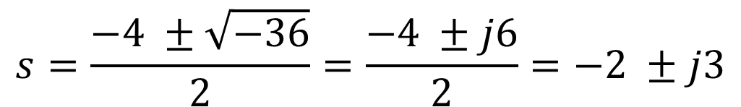
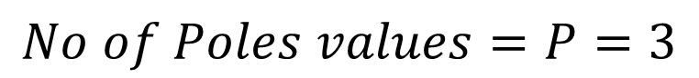
$$G\left(s\right)=\frac{k}{s(s^{2}+4s+13)}$$
Step-1: Calculate the Starting Points (Poles)
$$s=\frac{−b ±\sqrt{b^{2}−4ac}}{2a}=\frac{−4 ±\sqrt{4^{2}−4∗1∗13}}{2∗1}=\frac{−4 ±\sqrt{16−52}}{2}$$
$$s=\frac{−4 ±\sqrt{−36}}{2}=\frac{−4 ±j6}{2}=−2 ±j3$$
$$Poles :s=0, −2+j3, −2−j3$$
$$P_{1}=0,P_{2}=−2+j3,{\& P}_{3}=−2 −j3$$
$$No of Poles values=P=3$$
$$No of Root Locus Branches=No of Poles= 3$$

Slide 31
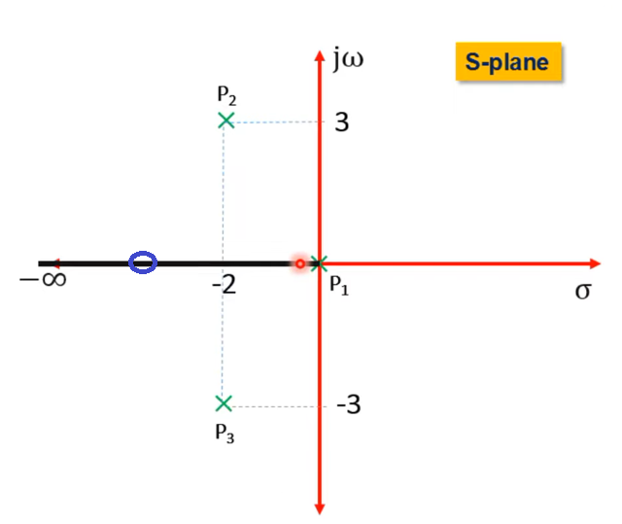
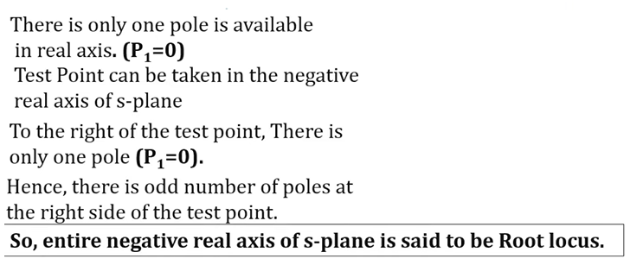
Step-2: Finding the root locus on real axis
Inspecting Region
Choose a test point only from real axis, and this test point is only one pole on right side, so that region is consider as a root locus, so highlighted it.

Slide 32
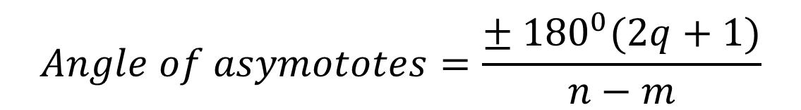
Step-3: Angle of Asymptotes And Centroid
$$Angle of asymototes=\frac{± {180}^{0}(2q+1)}{n−m}$$
$$n −No. of poles;m=No. of zeros, q=0, 1, 2, …n−m$$
$$if q=0 ↔AoA=\frac{± {180}^{0}(2q+1)}{n−m}=\frac{± {180}^{0}(2∗0+1)}{3−0}=± {60}^{0}$$
$$if q=1 ↔AoA=\frac{± {180}^{0}(2q+1)}{n−m}=\frac{± {180}^{0}(2∗1+1)}{3−0}=±180^{0}$$
$$if q=2↔AoA=\frac{± {180}^{0}(2q+1)}{n−m}=\frac{± {180}^{0}(2∗2+1)}{3−0}=±300^{0}= ∓\left(360−300\right)=∓60^{0}$$
$$if q=3↔AoA=\frac{± {180}^{0}(2q+1)}{n−m}=\frac{± {180}^{0}(2∗3+1)}{3−0}=±420^{0}=±\left(420−360\right)=±60^{0}$$

Slide 33
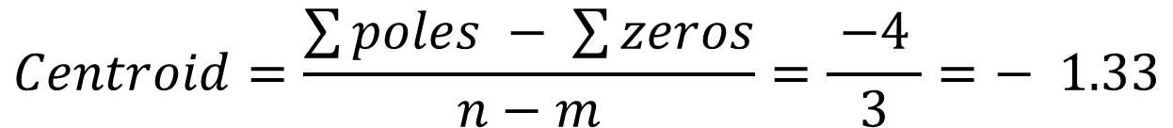
Step-3: Angle of Asymptotes And Centroid
$$Centroid=\frac{\sum{poles − \sum{zeros}}}{n−m}=\frac{{{{(P}_{1}+P}_{2}+P}_{3}) −(0)}{P−Z}=\frac{0 −2+j3−2−j3}{3−0}$$
$$Centroid=\frac{\sum{poles − \sum{zeros}}}{n−m}=\frac{ −4 }{3}=− 1.33$$

Slide 34
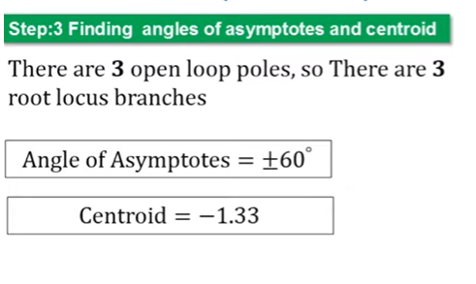
https://www.youtube.com/watch?v=_1wNh_NJ0co

